Slide 1
HTML 5

Slide 2
Features
New Elements
New Attributes
Full CSS3 Support
Video and Audio
2D/3D Graphics
Local Storage
Local SQL Database
Web Applications

Slide 3
How did this happen!!!
cooperation between the World Wide Web Consortium (W3C) and the Web Hypertext Application Technology Working Group (WHATWG).
WHATWG was working with web forms and applications, and W3C was working with XHTML 2.0. In 2006, they decided to cooperate and create a new version of HTML.
What were they trying to solve
Some rules for HTML5 were established:
New features should be based on HTML, CSS, DOM, and JavaScript
Reduce the need for external plugins (like Flash)
Better error handling
More markup to replace scripting
HTML5 should be device independent
The development process should be visible to the public

Slide 4
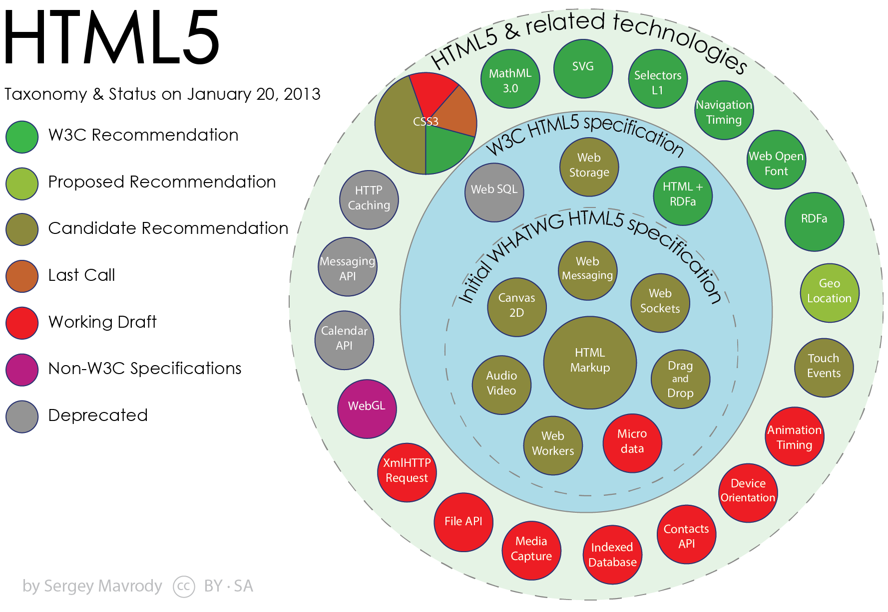

Slide 5
Tags
<article> Defines an article
<audio> Defines sound content
<canvas> Used to draw graphics, on the fly, via scripting (usually JavaScript)
<footer> Defines a footer for a document or section
<header> Defines a header for a document or section
<figcaption> Defines a caption for a <figure> element
<nav> Defines navigation links
<section> Defines a section in a document
<video> Defines a video or movie

Slide 6
Other Tags
<aside> Defines content aside from the page content
<command> Defines a command button that a user can invoke
<datalist> Specifies a list of pre-defined options for input controls
<details> Defines additional details that the user can view or hide
<bdi> Isolates a part of text that might be formatted in a different direction from other text outside it

Slide 7
Other Tags
<embed> Defines a container for an external (non-HTML) application
<figure> Specifies self-contained content
<hgroup> Groups heading (<h1> to <h6>) elements
<keygen> Defines a key-pair generator field (for forms)
<mark> Defines marked/highlighted text
<meter> Defines a scalar measurement within a known range (a gauge)
<output> Defines the result of a calculation

Slide 8
Other Tags
<progress> Represents the progress of a task
<rp> Defines what to show in browsers that do not support ruby annotations
<rt> Defines an explanation/pronunciation of characters (for East Asian typography)
<ruby> Defines a ruby annotation (for East Asian typography)
<source> Defines multiple media resources for media elements (<video> and <audio>)

Slide 9
Other Tags
<summary> Defines a visible heading for a <details> element
<time> Defines a date/time
<track> Defines text tracks for media elements (<video> and <audio>)
<wbr> Defines a possible line-break

Slide 10
Fond Farwell
<acronym>, <applet>, <basefont>, <big>, <center>,<dir>, <font>, <frame>, <frameset>, <noframes>, <strike>, <tt>

